Slide 2
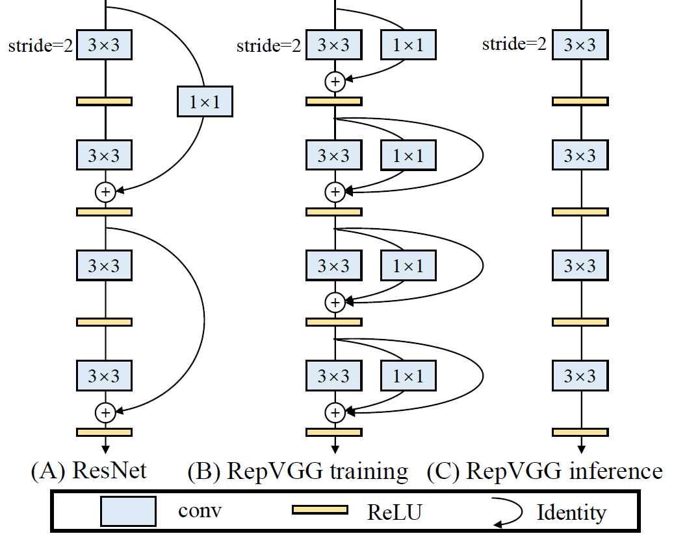
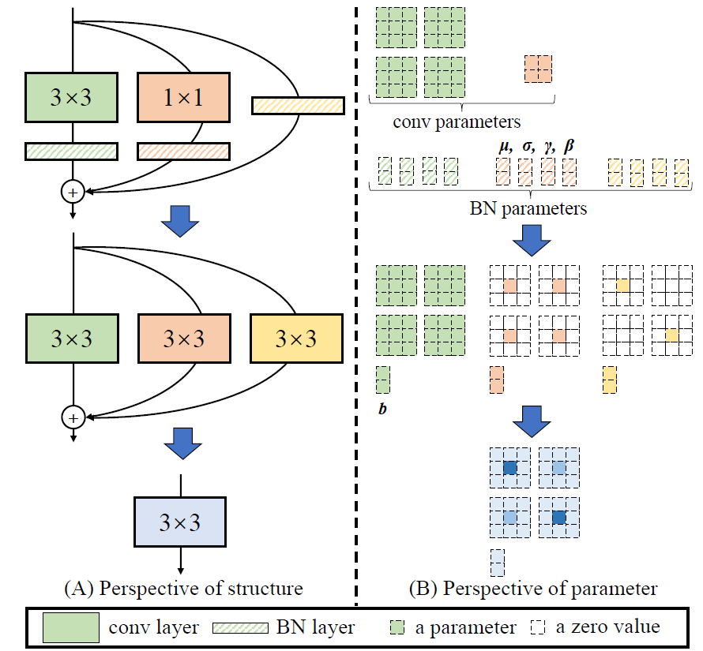

Slide 3
$$M^{(1)}∈ℝ^{N×C_{1}×H_{1}×W_{1}}$$
3×3
1×1
$$W^{(3)}∈ℝ^{C_{2}×C_{1}×3×3}$$
$$W^{(1)}∈ℝ^{C_{2}×C_{1}×1×1}$$
$$μ^{(3)} σ^{(3)} γ^{(3)} β^{(3)}$$
$$μ^{(1)} σ^{(1)} γ^{(1)} β^{(1)}$$
$$μ^{(0)} σ^{(0)} γ^{(0)} β^{(0)}$$
$$M^{(2)}∈ℝ^{N×C_{2}×H_{2}×W_{2}}$$

Slide 4
强惩罚(Group Lasso)
弱惩罚(Group Lasso)
CNN
CNN
高稀疏性
低稀疏性
易剪枝
难训练
易训练
难剪枝
😀
😭
😀
😭

Slide 5
-
-
+
-
-
+
-
重要
不重要
+
+
+
+
+
-
+
+
+
+
+
+
+
+
+
+
+
+
+
-
+
+
+
+
+
-
+
+
+
+
+
+
+
+
+
-
+
-
+
-
+
+
+
+
+
-
-
+
-
-
+
+
+
+
+
-
+
+
+
-
+
+
+
+
+
+
+
+
+
+
+
+
+
+
+
+
-
+
+
+
-
+
+
+
+
+
+
-
-
+
-
-
+
+
+
+
+
-
-
-
-
-
+
+
-
-
-
-
-
-
-
-
-
-
+
-
-
-
-
-
…
-
-
-
-
+
-
-
-
-
-
+
-
-
-
-
+
-
-
-
-
-
-
-
-
-
+
-
-
-
-
-
…
…
+
+
+
+
+
-
-
-
-
-
+
+
-
+
+
-
-
-
-
-
+
-
-
-
+
-
-
-
-
-
+
+
-
+
+
-
-
-
-
-
+
+
+
+
+
-
-
-
-
-

Slide 6
高性能、大模型
低性能、小模型
高性能、小模型
高性能、小模型
思路1
思路2

Slide 7
High-performance and large models
Low-performance and small models
model compression
structural re-parameterization
High-performance and small models
High-performance and small models

Slide 8







$$ℝ^{C×H×W}$$
$$ℝ^{D×C×1×1}$$
$$ℝ^{D×H×W}$$
$$ℝ^{E×D×K×K}$$
$$ℝ^{E×H^{′}×W^{′}}$$
Transpose
Before rep
When rep
After rep
$$ℝ^{C×D×1×1}$$
$$ℝ^{E×C×K×K}$$

Slide 9





$$ℝ^{C×H×W}$$
$$ℝ^{D×C×K×K}$$
$$ℝ^{D×H^{′}×W^{′}}$$
$$ℝ^{E×D×1×1}$$
$$ℝ^{E×H^{′}×W^{′}}$$
T
T
Before rep
When rep
After rep
$$ℝ^{C×D×K×K}$$
$$ℝ^{E×C×K×K}$$

